Slide 1
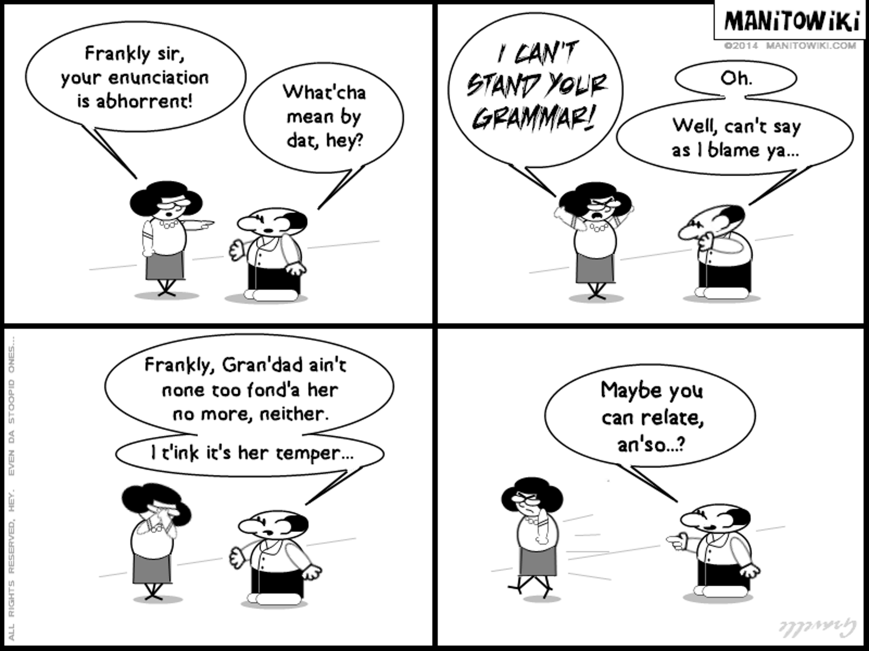
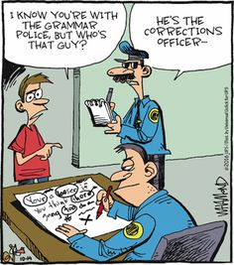
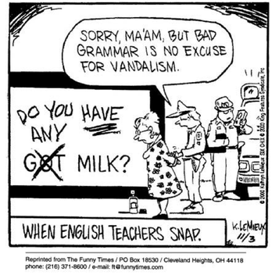
How to Grammar Check a Paper
By Taylor Tyle

Slide 2
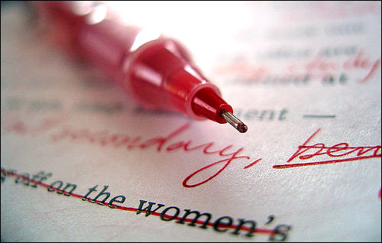
Pen and Paper
Even though fancy comment tools on Word are fun, nothing beats a red pen on paper. Grading this way will be so much easier for you and the writer.

Slide 3
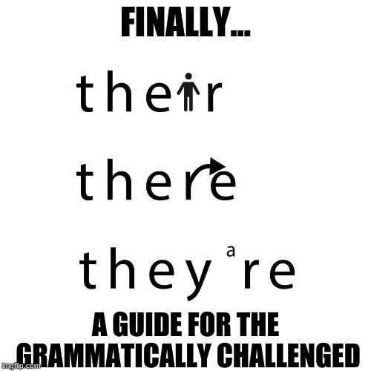
Basic Grammar Rules

Slide 4
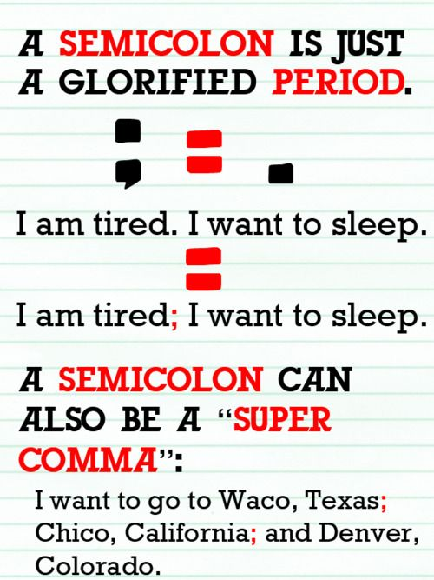
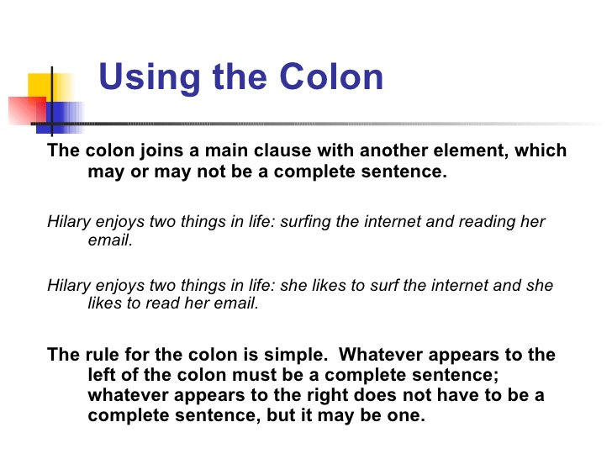
Semicolons and Colons
Complete sentence ; Complete sentence
Complete sentence: ____________

Slide 5
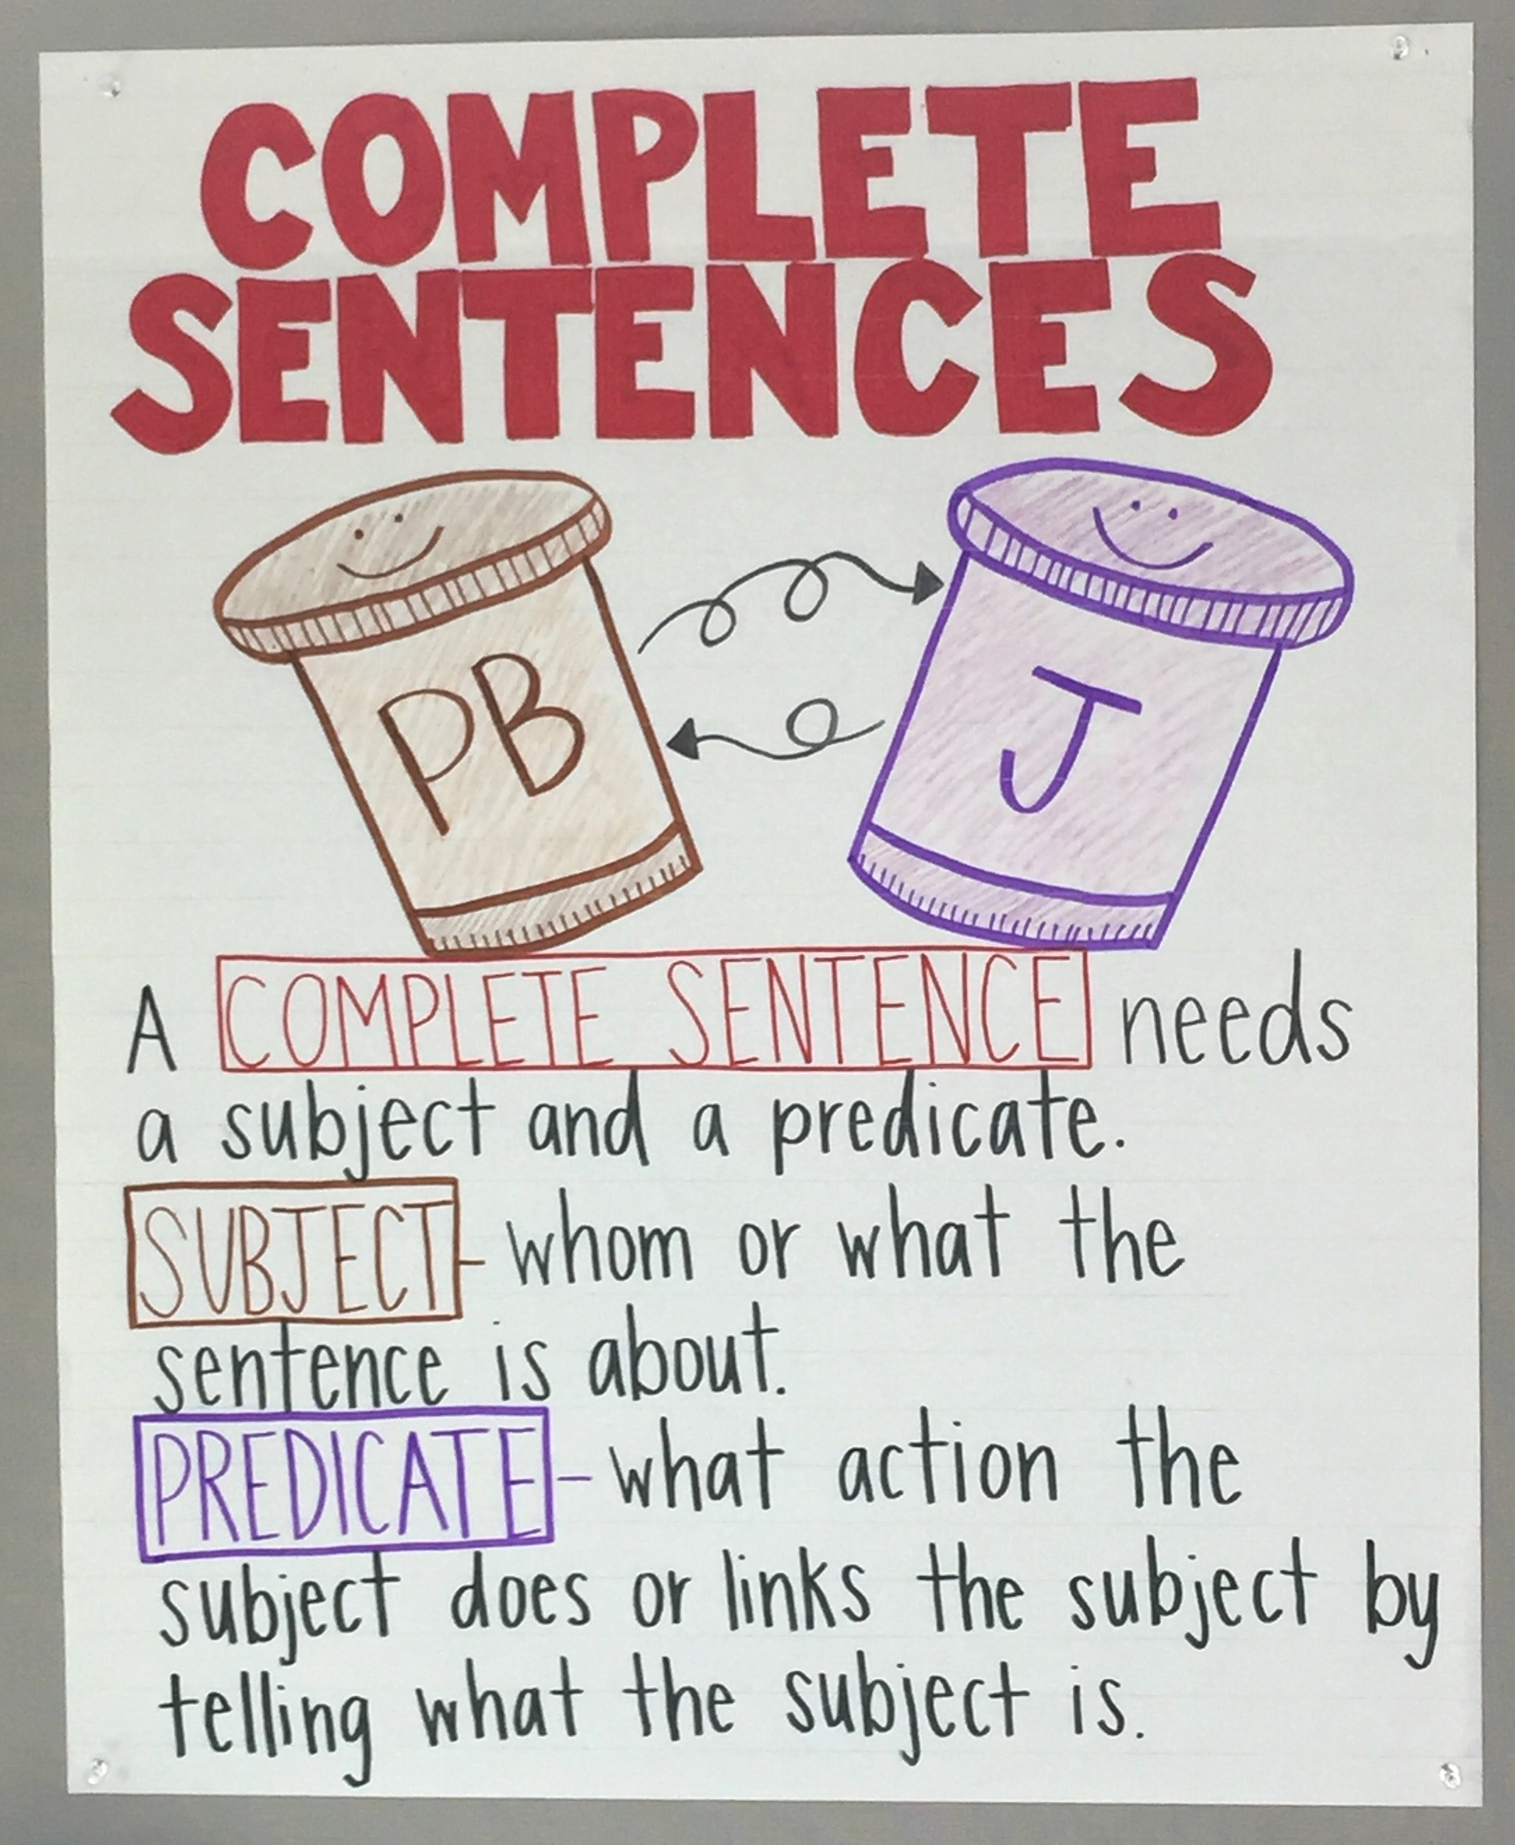
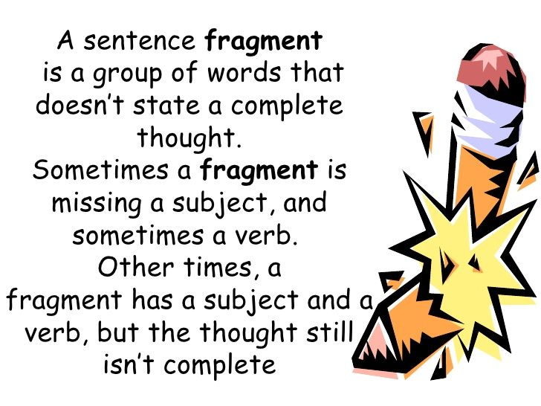
Complete Sentences
Because they were tired. = fragment
Because they were tired, Lily and Erin took a nap. = complete sentence

Slide 6
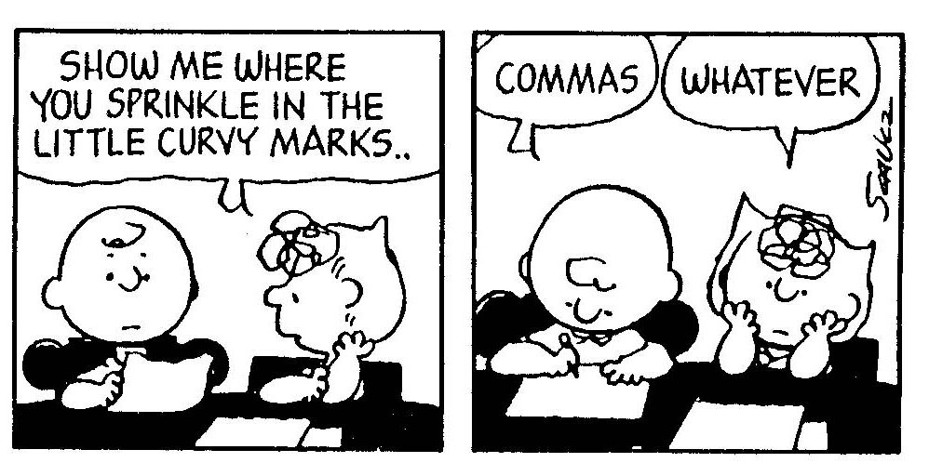
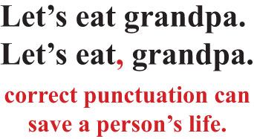
Commas
Commas are your friend!
As a grader reading a 5000 word paper, a lack of commas can be exhausting. Give the reader a break!
Although the food wasn’t what he would normally eat, John tried it anyways.
Mary wanted some soup, as she wasn’t feeling well.
A comma before ‘as’ changes the meaning to because!

Slide 7
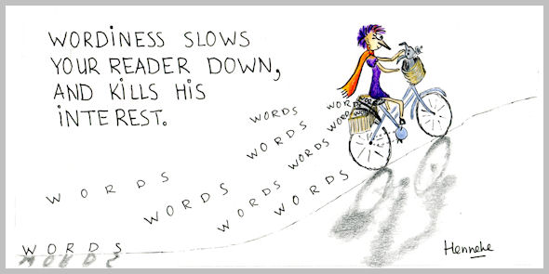
Wordy Sentences
It is possible that a wordy sentence is still grammatically correct, but concise writing is an important skill!
Show the writer places where they can break up their sentences! You can do this by adding /s in between words or adding a period and three lines under the letter of the next word to capitalize.

Slide 8
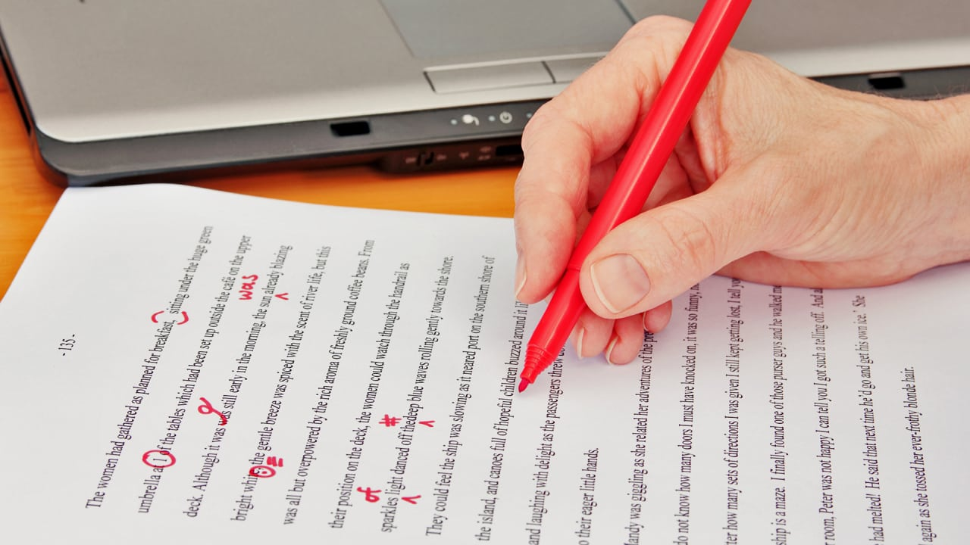
Short Cuts
Awk- awkward phrasing
Frag- Fragment
Circle spelling errors
Three lines under a letter- capitalize

Slide 9
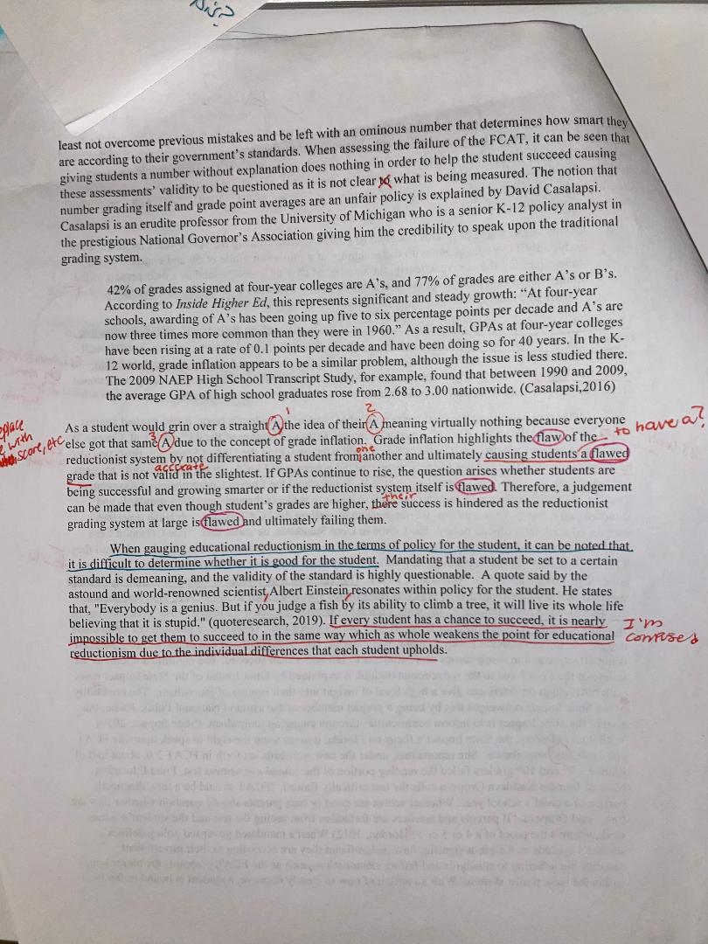
Here is a paper that I graded this past year.
Stylistic writing / sentence variety is so important!
Add in those missing words to help with clarity
There/Their/They’re!
I could’ve written ‘awk’ but we’re friends so it’s okay☺

Slide 10
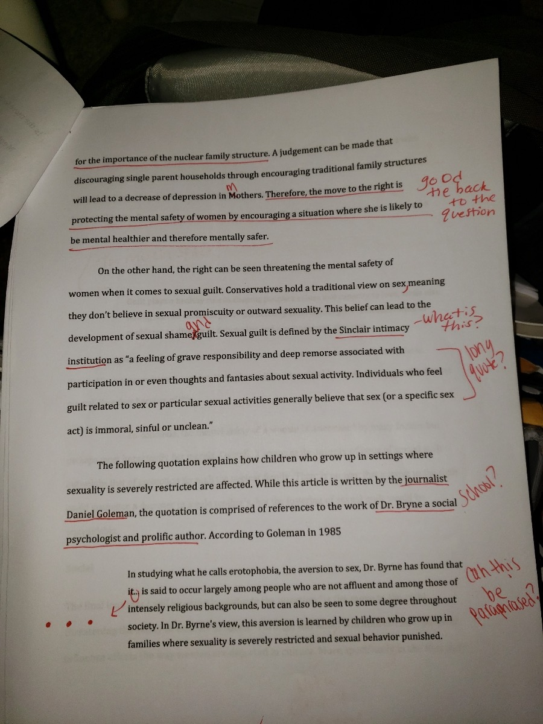
Another one of my friend’s papers that I graded ☺
Quotes that are three lines or longer should be in long quote format
Suggest shortening quotes by using an ellipsis ( . . . ) to take out unnecessary information or by paraphrasing

Slide 11

Why does it matter?
A 5000 word paper is hard enough to read, especially when its on a topic that is foreign to you.
Grammar mistakes can be distracting to your reader!
You want your reader to be focused and engaged on your content rather than your mistakes.

Slide 12

Remember
Giving somebody corrections isn’t mean; it’s helpful. They might be upset that they had so many errors, but they would be more upset if they submitted a grammatically flawed paper to Cambridge.
Be nice with your comments. Even if the paper is flawed, it is still a essay that your classmate has worked hard on and dedicated their time to.

